Slide 1
ResNet: Residual Neural Nets

Slide 2
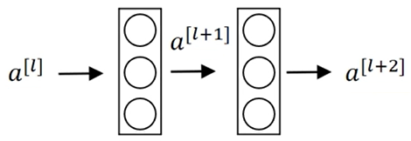


Residual block
short-cut / skip connection
$$⊕$$
$$a^{[l]}⟶\text{Linear}→z^{\left[l+1\right]}→\text{ReLU}→a^{[l+1]}=g\left(z^{\left[l+1\right]}\right)→\text{Linear}→z^{\left[l+2\right]}⟶\text{ReLU}→a^{\left[l+2\right]}=g(z^{[l+2]})$$
$$a^{\left[l+2\right]}=g(z^{\left[l+2\right]}+a^{[l]})$$
Using residual blocks we can build deeper networks!

Slide 3
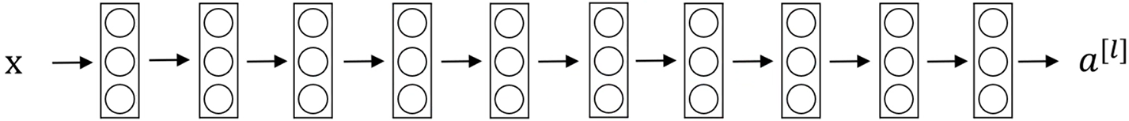
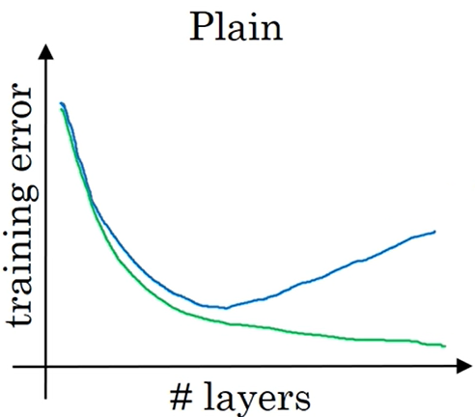
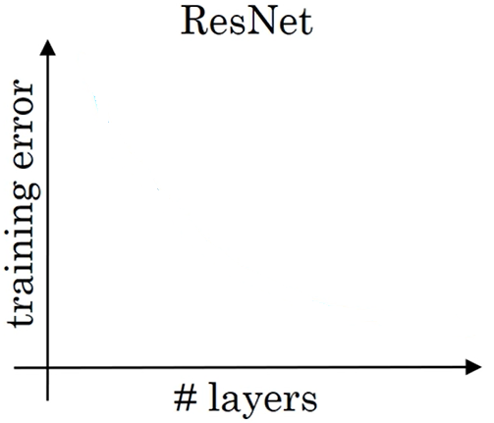
Residual Nets
Plain network
Residual net
exploding/vanishing gradient
reality
theory

Slide 4
K. He, X. Zhang, S. Ren and J. Sun, “Deep Residual Learning for Image Recognition,” in CVPR, 2016.

Slide 5
Shallow vs deep nets
If a “shallow” model is able to achieve an accuracy, then their deeper counterparts should at least have the same accuracy.
However, when the model gets deeper, it becomes more and more difficult for the layers to propagate the information from shallow layers and the information is lost (degradation problem).
To address this the problem, the deeper layers have to propagate the information from the shallow layers directly, i.e. identity mapping
Example: suppose we build a 9-layers net N1 and then a 30-layers net N2 by adding to N1 another 21 layers; if N2 performs worse than N1, we can get back N1 performance by making the 21 additional layers to learn the indentity mapping

Slide 6
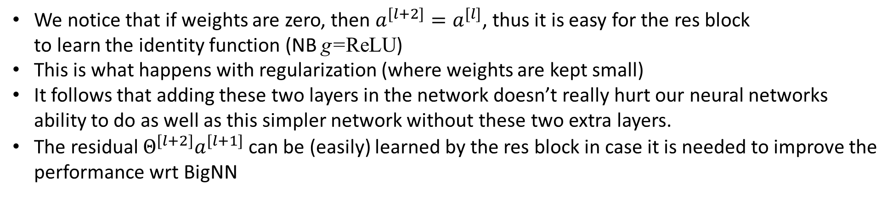





Why ResNet works?
BigNN
$$x⟶$$
$$⟶a^{[l]}$$
$$⟶$$
$$⟶$$
$$⟶ a^{[l+2]}$$
$$a^{[l+2]}=g(Θ^{\left[l+2\right]}a^{\left[l+1\right]}+a^{\left[l\right]})$$
We notice that if weights are zero, then $a^{[l+2]}=a^{[l]}$, thus it is easy for the res block
to learn the identity function (NB g=ReLU)
This is what happens with regularization (where weights are kept small)
It follows that adding these two layers in the network doesn’t really hurt our neural networks
ability to do as well as this simpler network without these two extra layers.
The residual $Θ^{[l+2]}a^{[l+1]}$ can be (easily) learned by the res block in case it is needed to improve the
performance wrt BigNN

Slide 7
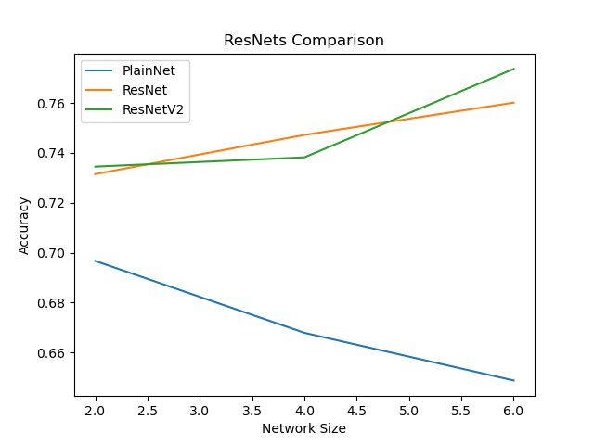
Typical situation

Slide 8
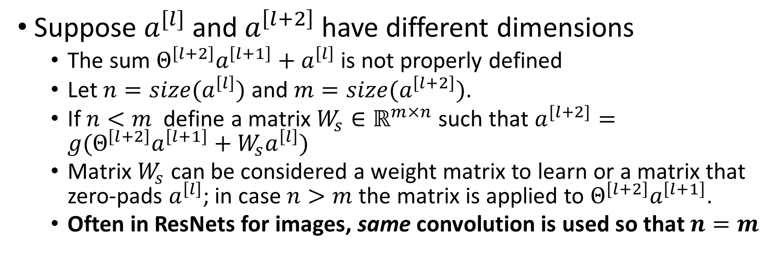





$$a^{[l+2]}=g(Θ^{\left[l+2\right]}a^{\left[l+1\right]}+a^{\left[l\right]})$$
$$a^{[l]}$$
$$⟶$$
$$⟶$$
$$⟶ a^{[l+2]}$$
Suppose $a^{[l]}$ and $a^{\left[l+2\right]}$ have different dimensions
  The sum $Θ^{\left[l+2\right]}a^{\left[l+1\right]}+a^{\left[l\right]}$ is not properly defined
  Let $n=size(a^{\left[l\right]})$ and $m=size(a^{\left[l+2\right]})$.
  If $n<m$ define a matrix $W_{s}∈ℝ^{m×n}$ such that $a^{[l+2]}=g(Θ^{\left[l+2\right]}a^{\left[l+1\right]}+W_{s}a^{\left[l\right]})$
  Matrix $W_{s}$ can be considered a weight matrix to learn or a matrix that zero-pads $a^{\left[l\right]}$; in case $n>m$ the matrix is applied to $Θ^{\left[l+2\right]}a^{\left[l+1\right]}$.
  Often in ResNets for images, same convolution is used so that $n=m$

Slide 9
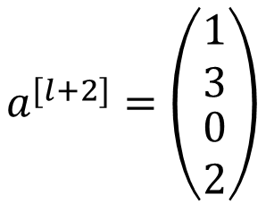
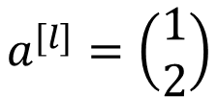
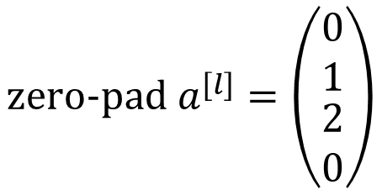
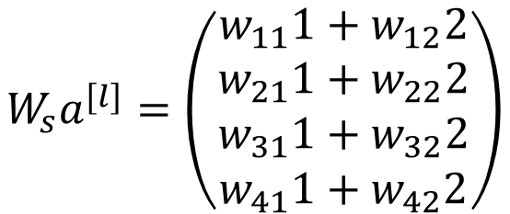
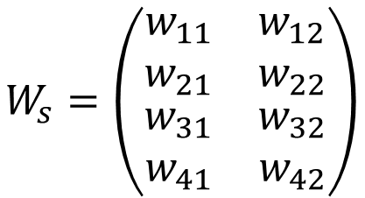
Example: a possible zero-pad
$$a^{[l+2]}=\left(\begin{matrix}\begin{matrix}1 \\ 3\end{matrix} \\ \begin{matrix}0 \\ 2\end{matrix}\end{matrix}\right)$$
$$a^{[l]}=\left(\begin{matrix}1 \\ 2\end{matrix}\right)$$
$$W_{s}=\left(\begin{matrix}\begin{matrix}w_{11} \\ w_{21}\end{matrix} & \begin{matrix}w_{12} \\ w_{22}\end{matrix} \\ \begin{matrix}w_{31} \\ w_{41}\end{matrix} & \begin{matrix}w_{32} \\ w_{42}\end{matrix}\end{matrix}\right)$$
$$W_{s}a^{[l]}=\left(\begin{matrix}\begin{matrix}w_{11}1+w_{12}2 \\ w_{21}1+w_{22}2\end{matrix} \\ \begin{matrix}w_{31}1+w_{32}2 \\ w_{41}1+w_{42}2\end{matrix}\end{matrix}\right)$$
$$\text{zero}\text{−}\text{pad} a^{[l]}=\left(\begin{matrix}\begin{matrix}0 \\ 1\end{matrix} \\ \begin{matrix}2 \\ 0\end{matrix}\end{matrix}\right)$$
$$w_{11}1+w_{12}2=0 →w_{11}=0 w_{12}=0$$
$$w_{21}1+w_{22}2=1 →w_{21}=1 w_{22}=0$$
$$w_{31}1+w_{22}2=2 →w_{31}=0 w_{32}=1$$
$$w_{41}1+w_{42}2=0 →w_{41}=0 w_{42}=0$$

Slide 10
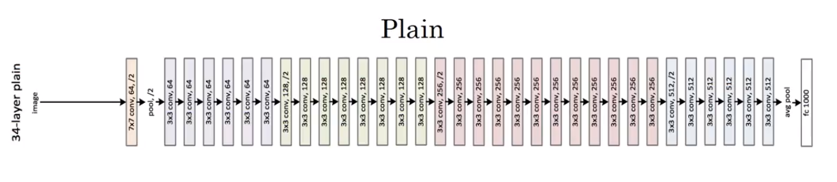

ResNet on Images: ResNet34
This is an example of a plain network in which we input an image and then have a number of conv layers until eventually we have a softmax output at the end.
$7×7 \text{conv}$, 64 → 64 filtri 7x7
$3×3 \text{conv}$, 128, /2 → 128 filtri 3x3 seguiti da un pool che dimezza size (2x2)
Se non detto diversamente stride=1

Slide 11
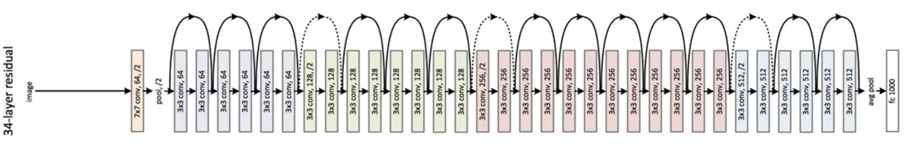
ResNet64

